Slide 1




Theory & approaches in emission process modelling
Application of CFD
Özer Bağcı
16.04.2019

Slide 2
CFD = Computational Fluid Dynamics
CFD is any numerical path taken to approximate
Velocity components,
Pressure,
All other transported flow variables (Energy, chemical species)

Slide 3
CFD = Computational Fluid Dynamics
The fundamental 4 variables: Pressure (p), Velocity in x, y, and z directions; u, v and w, respectively
Therefore 4 fundamental equations have to be solved:
Mass conservation
Momentum conservation (Navier-Stokes)

Slide 4
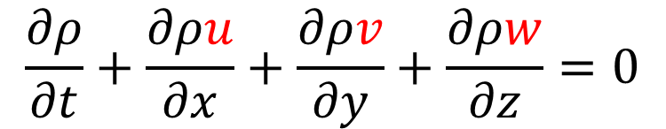
Conservation equations
Mass conservation
$$\frac{∂ρ}{∂t}+\frac{∂ρu}{∂x}+\frac{∂ρv}{∂y}+\frac{∂ρw}{∂z}=0$$

Slide 5
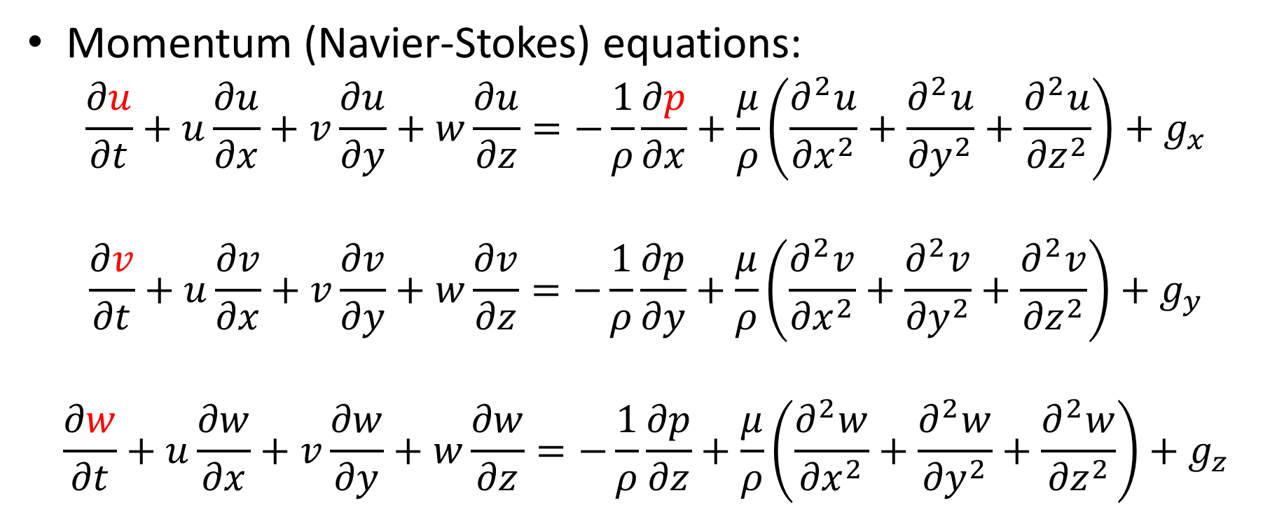
Conservation equations
Momentum (Navier-Stokes) equations:
$$\frac{∂u}{∂t}+u\frac{∂u}{∂x}+v\frac{∂u}{∂y}+w\frac{∂u}{∂z}=−\frac{1}{ρ}\frac{∂p}{∂x}+\frac{μ}{ρ}\left(\frac{∂^{2}u}{{∂x}^{2}}+\frac{∂^{2}u}{{∂y}^{2}}+\frac{∂^{2}u}{{∂z}^{2}}\right)+g_{x}$$
$$\frac{∂v}{∂t}+u\frac{∂v}{∂x}+v\frac{∂v}{∂y}+w\frac{∂v}{∂z}=−\frac{1}{ρ}\frac{∂p}{∂y}+\frac{μ}{ρ}\left(\frac{∂^{2}v}{{∂x}^{2}}+\frac{∂^{2}v}{{∂y}^{2}}+\frac{∂^{2}v}{{∂z}^{2}}\right)+g_{y}$$
$$\frac{∂w}{∂t}+u\frac{∂w}{∂x}+v\frac{∂w}{∂y}+w\frac{∂w}{∂z}=−\frac{1}{ρ}\frac{∂p}{∂z}+\frac{μ}{ρ}\left(\frac{∂^{2}w}{{∂x}^{2}}+\frac{∂^{2}w}{{∂y}^{2}}+\frac{∂^{2}w}{{∂z}^{2}}\right)+g_{z}$$

Slide 6
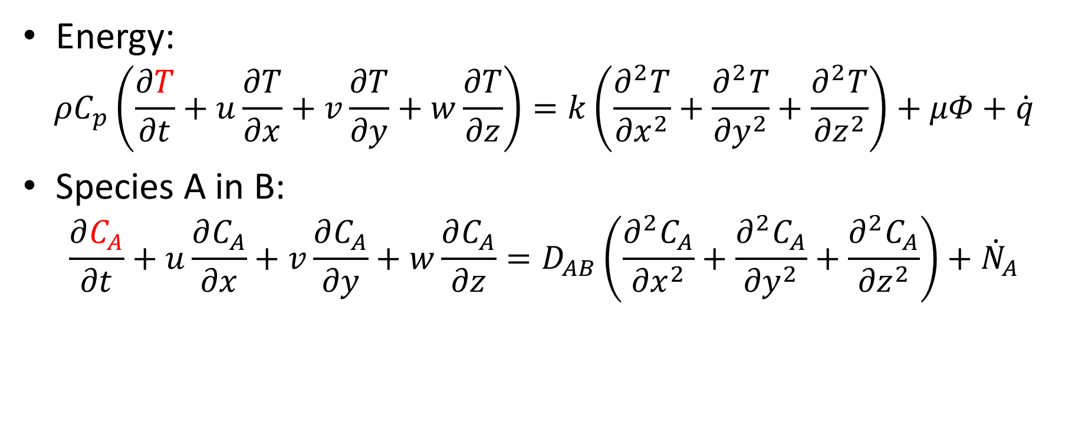
Conservation equations
Energy:
$$ρC_{p}\left(\frac{∂T}{∂t}+u\frac{∂T}{∂x}+v\frac{∂T}{∂y}+w\frac{∂T}{∂z}\right)=k\left(\frac{∂^{2}T}{{∂x}^{2}}+\frac{∂^{2}T}{{∂y}^{2}}+\frac{∂^{2}T}{{∂z}^{2}}\right)+μΦ+\dot{q}$$
Species A in B:
$$\frac{∂C_{A}}{∂t}+u\frac{∂C_{A}}{∂x}+v\frac{∂C_{A}}{∂y}+w\frac{∂C_{A}}{∂z}=D_{AB}\left(\frac{∂^{2}C_{A}}{{∂x}^{2}}+\frac{∂^{2}C_{A}}{{∂y}^{2}}+\frac{∂^{2}C_{A}}{{∂z}^{2}}\right)+{\dot{N}}_{A}$$

Slide 7
Some discretization schemes
Finite difference (Open-source codes, educational purposes)
Finite element (COMSOL, Autodesk)
Finite volume (Fluent, CFX)
Notes:
All of those three popular discretization methods serve the purpose of turning differential equations into algebraic ones to make a problem be solvable in a computer environment.
Finite difference is the method with the most physical significance, however it has deemed weak because of the modern need of complex geometries and the need for fast adaptation of computational grids.
Finite element method in structural analyses has gained tremendous popularity however its lower physical insignificance due to its Galerkin’s-method-of-weighted-residual roots has caused finite volume gain much more trust because finite volume method is based on merely reaching flow variables at nodes by approximating physical fluxes on either side.

Slide 8
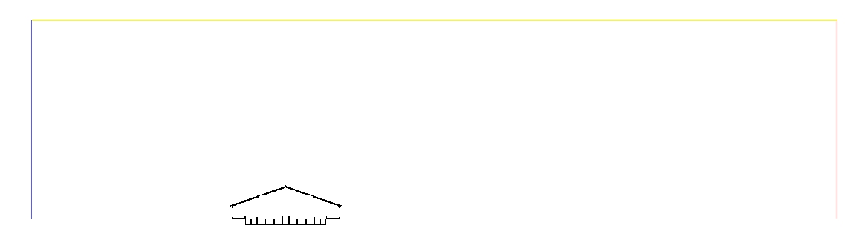
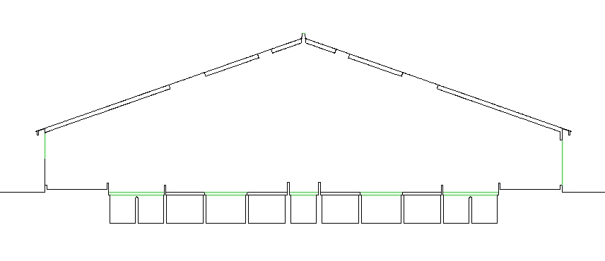
Pre-processing: Geometry generation
Ridge opening
2D
Axi-symmetric
3D
3D Periodic
Wind inlet (Log velocity profile)
Barn outlet
Barn inlet
Barn
slats
Manure pits

Slide 9
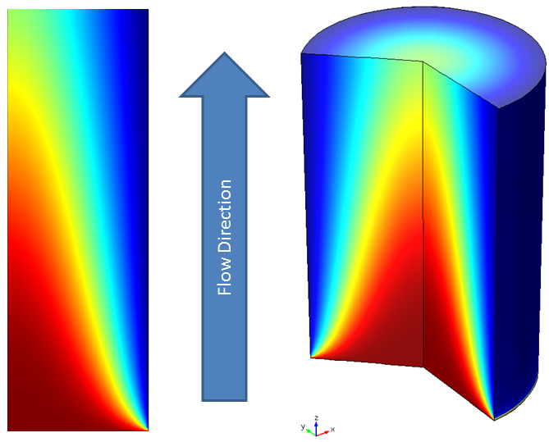
Pre-processing: Geometry generation
2D
Axi-symmetric
3D
3D Periodic

Slide 10
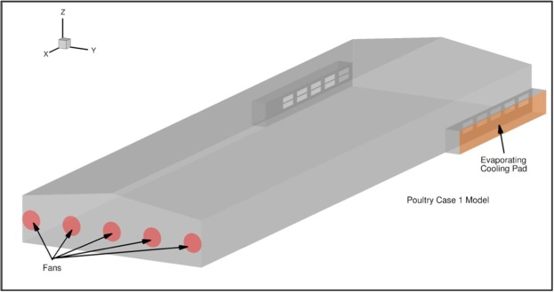
Pre-processing: Geometry generation
2D
Axi-symmetric
3D
3D Periodic
Fidaros et al., 2018
Notes:
Figure from
Fidaros, D., Baxevanou, C., Bartzanas, T., & Kittas, C. (2018). Numerical study of mechanically ventilated broiler house equipped with evaporative pads. Computers and Electronics in Agriculture, 149, 101-109.

Slide 11
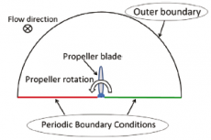
Pre-processing: Geometry generation
2D
Axi-symmetric
3D
3D Periodic
Notes:
Figure from
https://www.aerodefensetech.com/component/content/article/adt/features/articles/19754

Slide 12
Geometry generation tools
Spaceclaim (ANSYS)
Design modeler (ANSYS)
Solidworks
AutoCAD
…

Slide 13
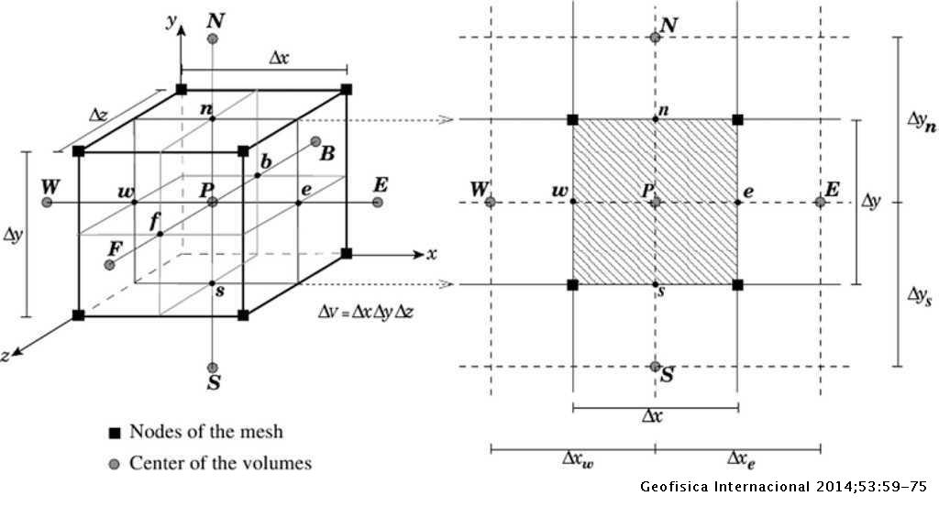
Meshing
De la Cruz & Monsivais, 2014
Notes:
de la Cruz, L. M., & Monsivais, D. (2014). Parallel numerical simulation of two-phase flow model in porous media using distributed and shared memory architectures. Geofísica internacional, 53(1), 59-75.

Slide 14
Meshing tools
ICEM CFD (ANSYS)
ANSYS Meshing
Gambit (ANSYS)
Pointwise
Notes:
For each of the software, there is a learning curve. They are also not very user-friendly. Tutorials are available upon purchase and the experience is built via discoveries of case-specific meshing strategies especially if the mesh is structured

Slide 15
Overview of turbulence models
K-ɛ
Standard
RNG
Realizable
K-ω
SST
LES
DNS
Notes:
Standard: for fully developed turbulent flows. Therefore not correct for enclosures with very unsteady characteristics
RNG: Small eddies are represented by a modified turbulence model. Superior standard k-epsilon in the case of separating flows
Realizable: Superior to Standard model in terms of rotational: separated and recirulating flows. It has an adaptive nature wrt. the simulated flow therefore, it gives better results than RNG as well in enclosures.
SST: The k-omega model, performing very well in the boundary layer model, has been blended with k-epsilon performing better in the free stream zone. SST is known to perform well in high-Rayleigh number, buoyancy-driven flow.
LES has proven to be accurate in enclosures. However, it tries to solve the anisotropic nature of the flow. Therefore it is the most expensive one until DNS.

Slide 16
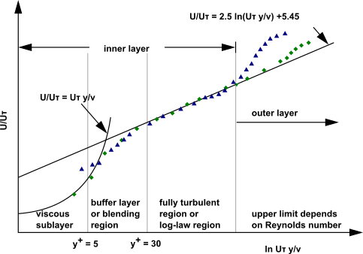
Mesh-related treatment
Wall functions
Near-Wall approach
Failsafe option:
10-20 cells along the boundary layer height
Notes:
Wall functions: They help reduction of cell number. However, if refined too much unintentionally, divergence occurs
Near-wall: There is always a maximum because of too little aspect ratios and cell numbers
The failsafe option: Turbulence viscosity can be plotted. Maximum is in the middle of the boundary layer. This height can be spanned by 10-20 cells

Slide 17
Post-processing
Fluent and CFX already have built in viewers
CFD Post
EnSight
Tecplot

Slide 18
Ammonia emission modeling
What has been done?
2D NV dairy cattle barn
Temperature dependent ammonia flux from release surface
Ammonia distribution in the animal occupied zones
Substitution of slats with porous media models
Attempt to incorporate porous media approach to chicken geometry

Slide 19
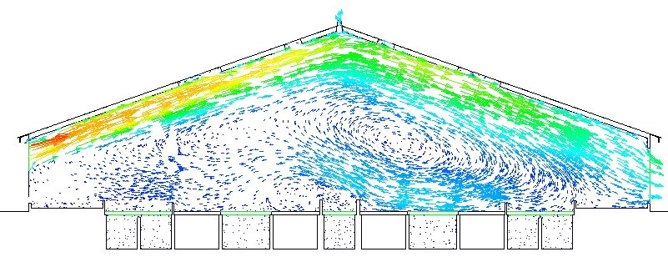
Naturally ventilated barn and flow in the pits
Notes:
The inlet has been modeled half-open. Lower half of the inlet is completely air-impermeable.

Slide 20
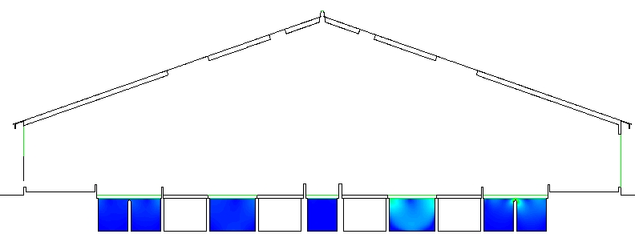
Naturally ventilated barn and flow in the pits

Slide 21
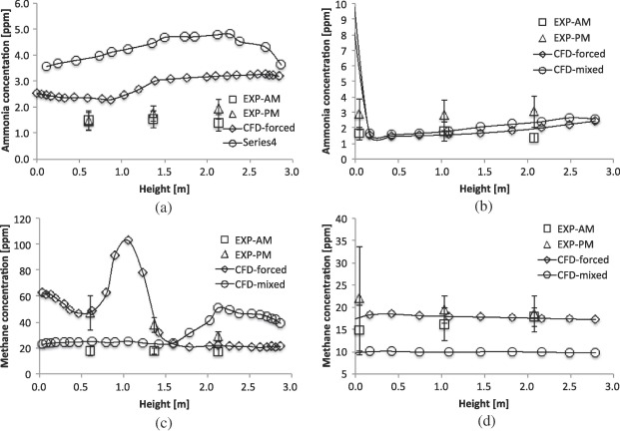
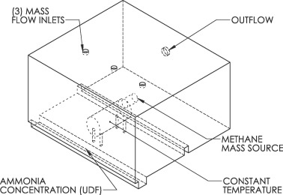
Temperature-dependent ammonia release
Drewry et al., 2018
Notes:
Drewry, J. L., Choi, C. Y., Powell, J. M., & Luck, B. D. (2018). Computational model of methane and ammonia emissions from dairy barns: Development and validation. Computers and Electronics in Agriculture, 149, 80-89.

Slide 22
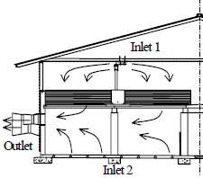
Ammonia distribution
Sun et al. 2004
Notes:
Sun, H., Keener, H. M., Deng, W., & Michel Jr, F. C. (2004). Development and validation of 3-d CFD models to simulate airflow and ammonia distribution in a high-rise™ hog building during summer and winter conditions. Agricultural Engineering International: CIGR Journal.

Slide 23
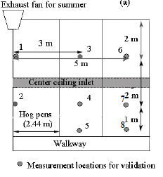
Ammonia distribution
Sun et al. 2004

Slide 24
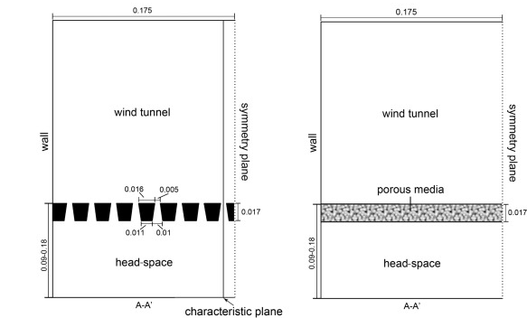
Substitution of slats with porous media
Yin et al., 2016
Notes:
Yin, S., van’t Ooster, B., Ogink, N. W., & Koerkamp, P. W. G. (2016). Assessment of porous media instead of slatted floor for modelling the airflow and ammonia emission in the pit headspace. Computers and Electronics in Agriculture, 123, 163-175.

Slide 25
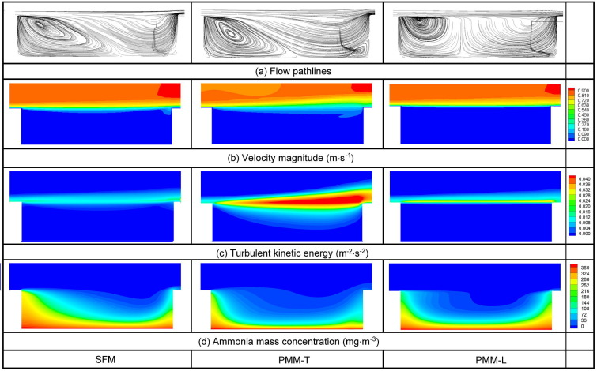
Substitution of slats with porous media
Yin et al., 2016
Notes:
Yin, S., van’t Ooster, B., Ogink, N. W., & Koerkamp, P. W. G. (2016). Assessment of porous media instead of slatted floor for modelling the airflow and ammonia emission in the pit headspace. Computers and Electronics in Agriculture, 123, 163-175.

Slide 26
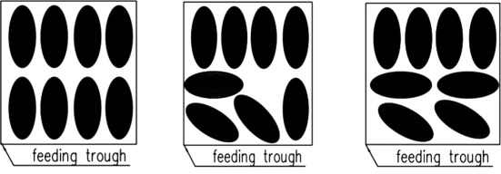
Porous media resistance coefficients of chicken
Cheng et al., 2018
Notes:
Cheng, Q., Wu, W., Li, H., Zhang, G., & Li, B. (2018). CFD study of the influence of laying hen geometry, distribution and weight on airflow resistance. Computers and electronics in agriculture, 144, 181-189.
Results:
Hen distributions have significant effect on flow resistance of Chicken zone. But some specific situations could be regarded as having the similar resistance coefficients. Therefore, when modelling Chicken zone as porous media, the hen distribution situations in house should be monitored and considered.
Body weight strongly affects the resistance of CZ. The flow resistance increases with weight while its variation decreases. It indicates that hen’s body weight should be taken into consideration.

Slide 27
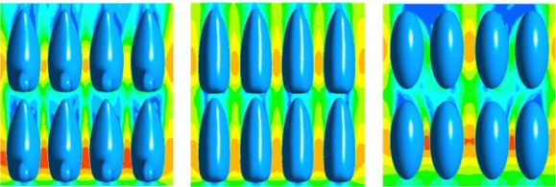
Porous media resistance coefficients of chicken
Cheng et al., 2018
Notes:
Cheng, Q., Wu, W., Li, H., Zhang, G., & Li, B. (2018). CFD study of the influence of laying hen geometry, distribution and weight on airflow resistance. Computers and electronics in agriculture, 144, 181-189.
Results:
Hen distributions have significant effect on flow resistance of Chicken zone. But some specific situations could be regarded as having the similar resistance coefficients. Therefore, when modelling Chicken zone as porous media, the hen distribution situations in house should be monitored and considered.
Body weight strongly affects the resistance of CZ. The flow resistance increases with weight while its variation decreases. It indicates that hen’s body weight should be taken into consideration.

Slide 28
Ammonia emission modeling
What has yet to be done?
More meticulous incorporation of slats as porous media
Substitution of chicken by porous media tailored according to age
Modeling of drying mechanism of poultry litter

Slide 29
Bibles on CFD (IMHO)
Suhas Patankar (1980). Numerical Heat Transfer and Fluid Flow
John D. Anderson (1995). Computational Fluid Dynamics: The Basics With Applications.
Henk Kaarle Versteeg, Weeratunge Malalasekera (2007). An Introduction to Computational Fluid Dynamics: The Finite Volume Method
Joel H. Ferziger, Milovan Perić (1999). Computational Methods for Fluid Dynamics

Slide 30
Some very helpful online sources
www.cfd-online.com
www.computationalfluiddynamics.com.au

